Slide 1
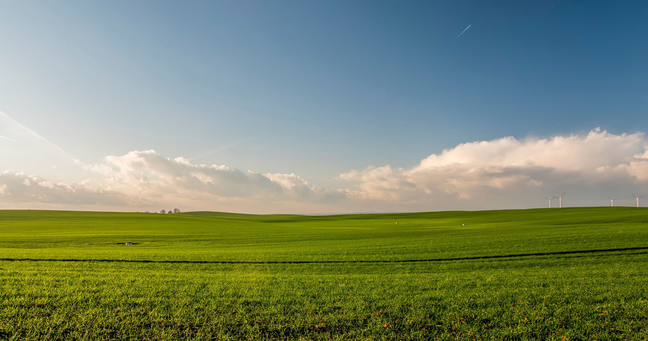

AGRIFARM
Connecting Farmers to Buyers Through Digital Innovation
Project by:
DARSHAN R.
M KUSUMA

Slide 2
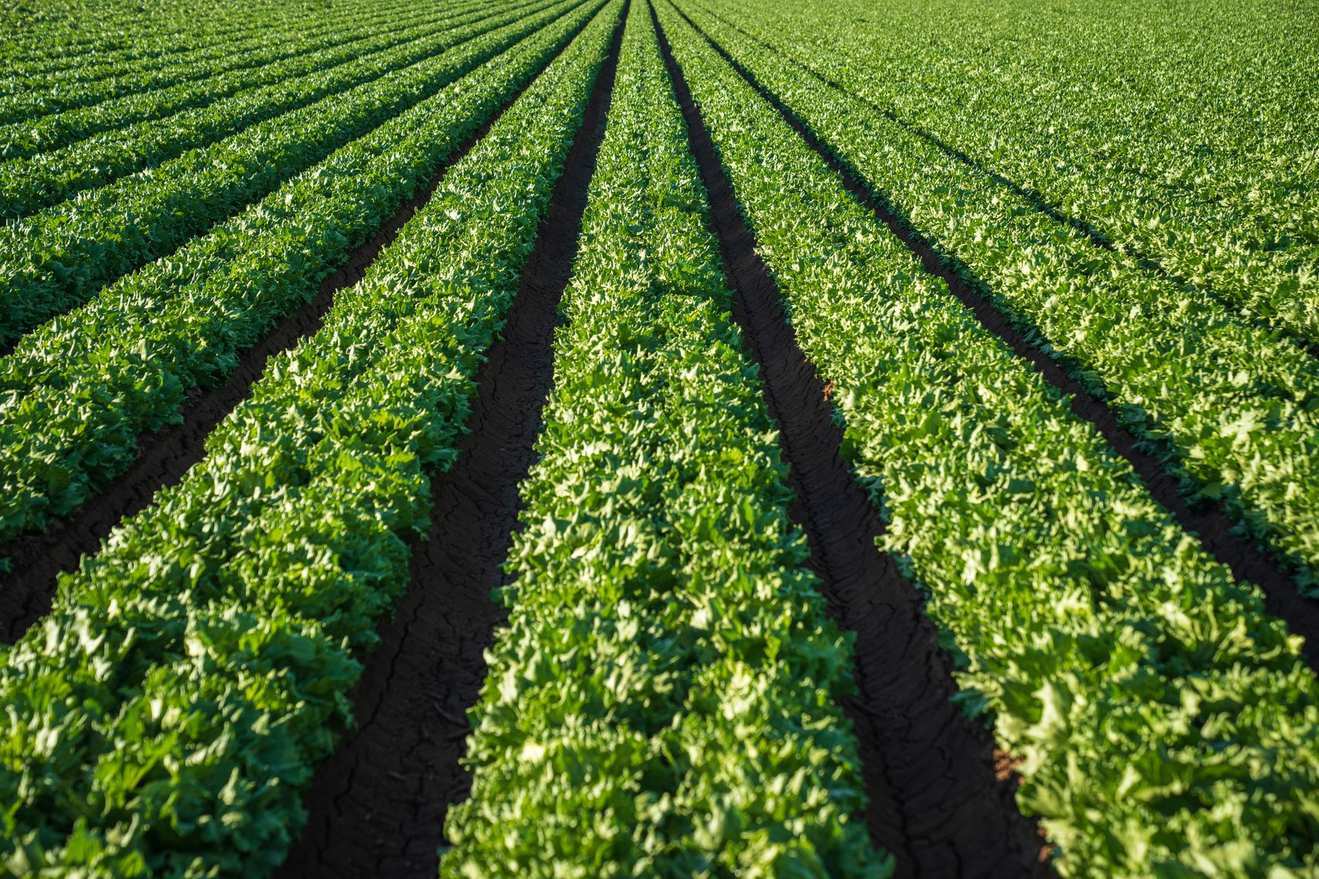
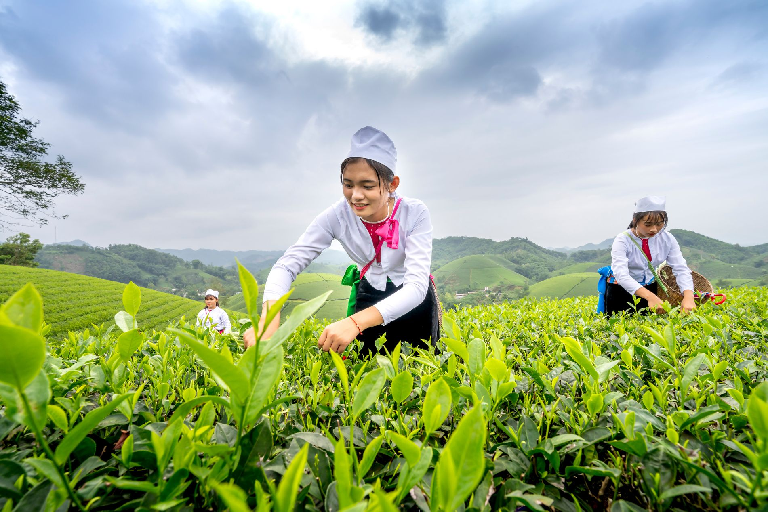
02
INTRODUCTION
Motivation Behind the Project: The agricultural industry, particularly small-scale farmers, often faces challenges in accessing larger markets and ensuring fair prices for their produce. With the rapid growth of digital technologies, there is a pressing need to modernize farming operations, giving farmers better access to consumers while eliminating the need for middlemen who cut into their profits. Our project aims to bring farming into the digital age, empowering farmers through technology.
Core Idea: This project is about building a user-friendly online platform where farmers can directly list, showcase, and sell their products to consumers. By creating a seamless, easy-to-use interface, farmers can manage their own online stores, and buyers can conveniently browse and purchase fresh produce from local farmers.

Slide 3
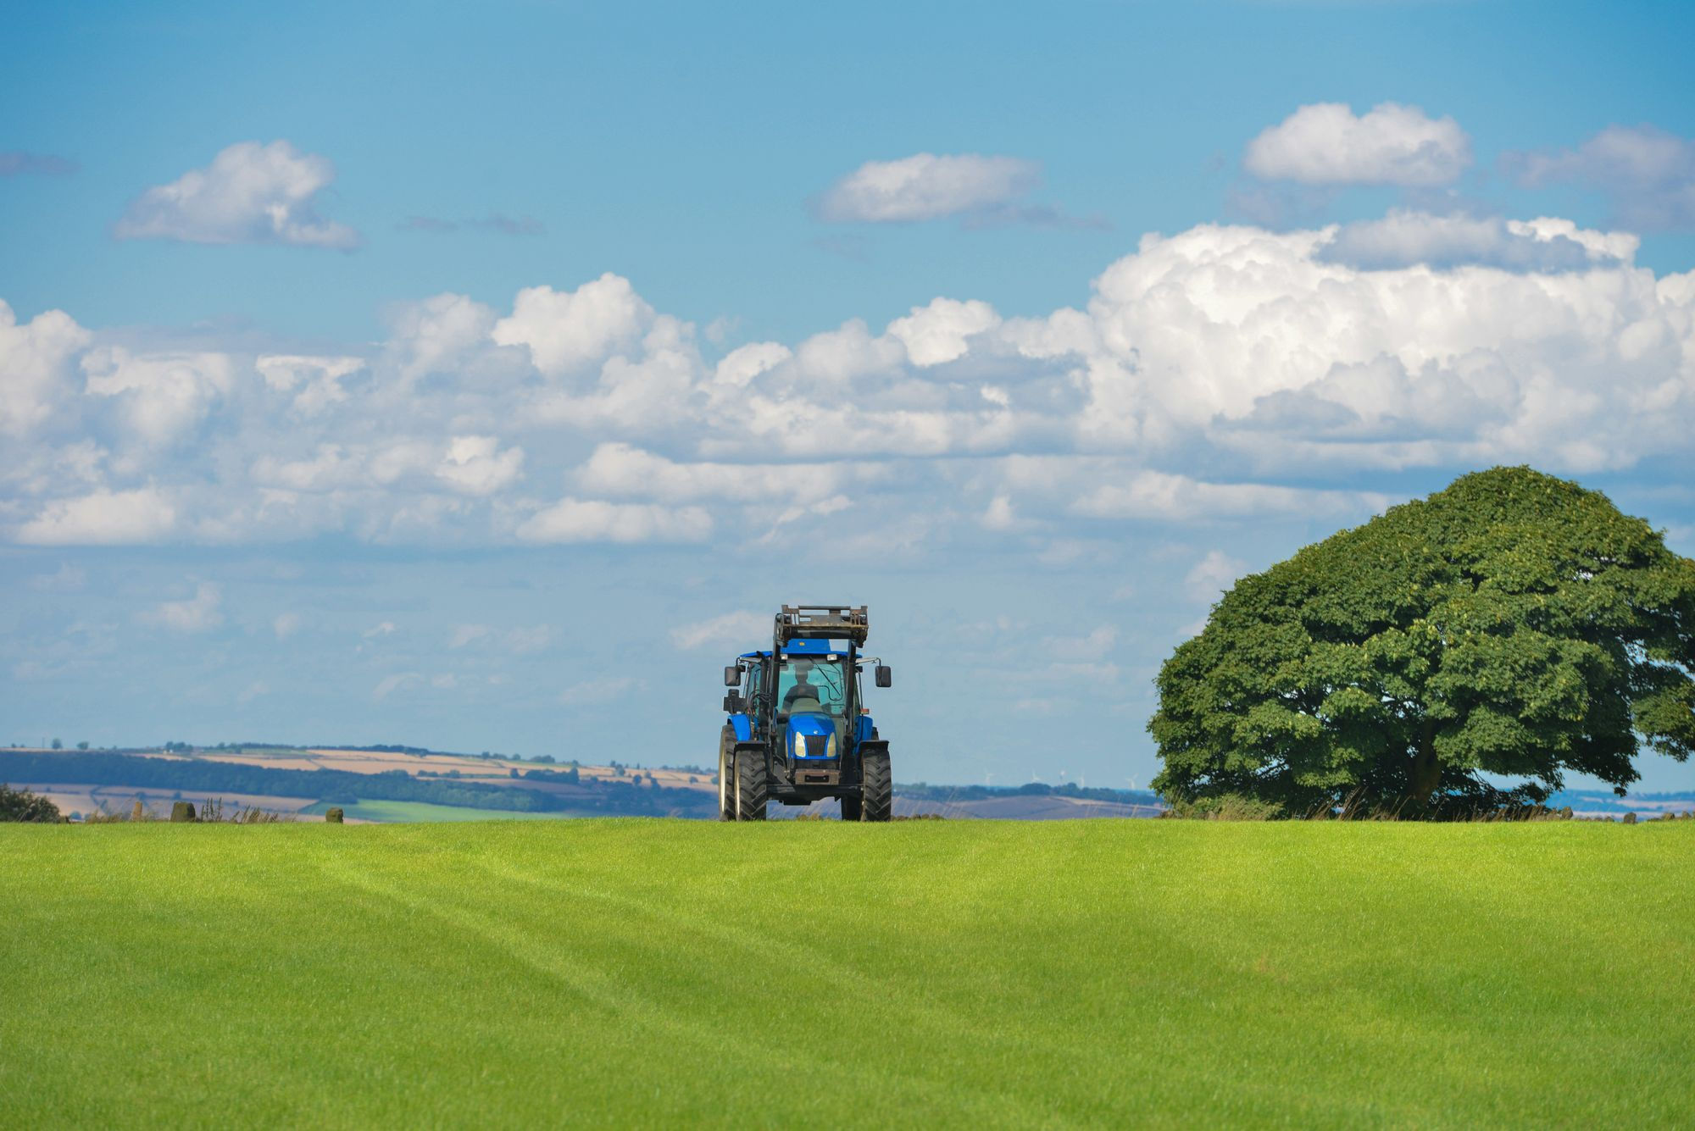
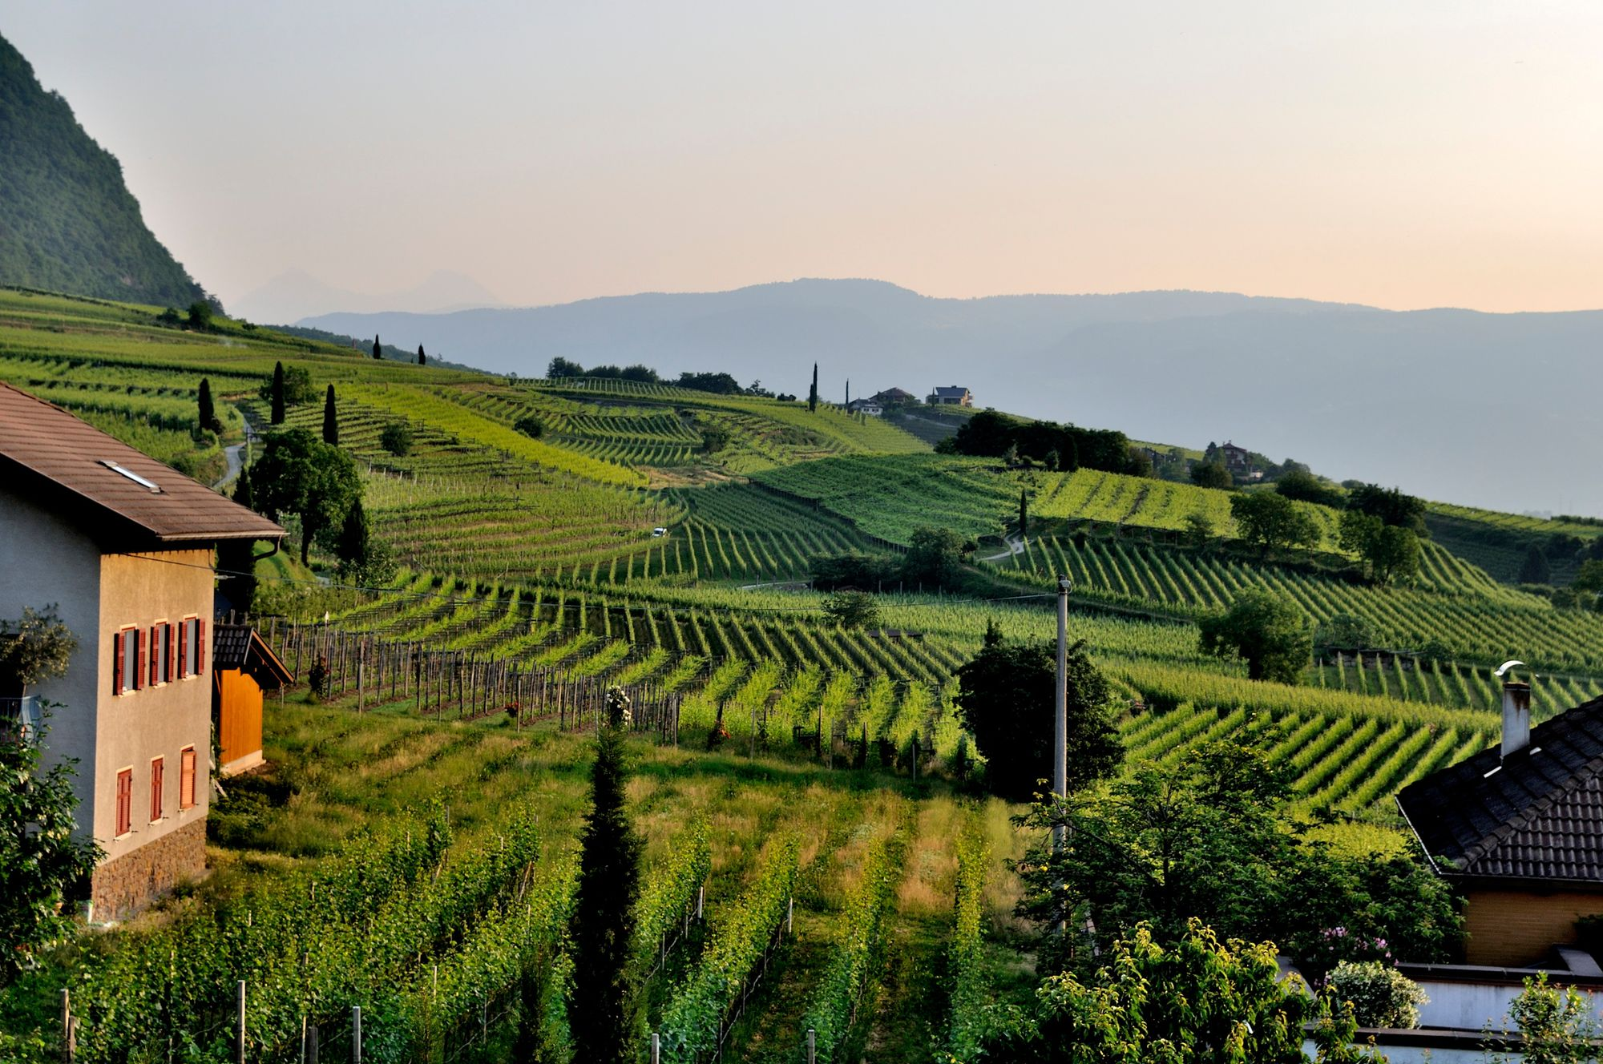
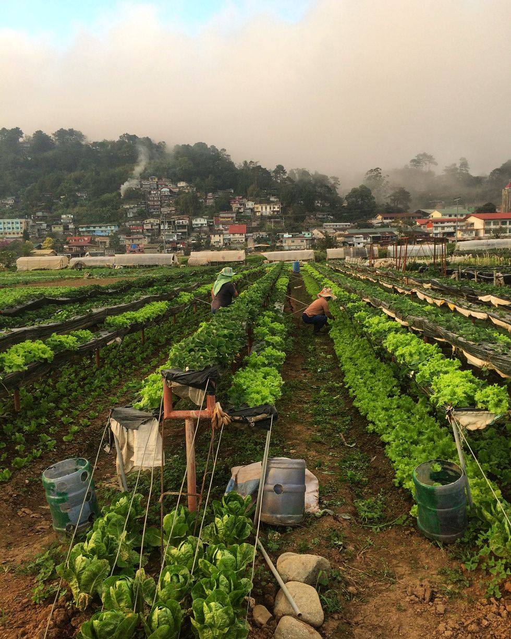
Problem Statement
03
Farmers often struggle to reach larger markets and secure fair prices for their products due to dependence on middlemen. This leads to reduced profits and limited market access. Additionally, there is a lack of digital infrastructure that supports direct farmer-to-consumer sales. Consumers, on the other hand, find it challenging to access fresh, local produce easily. This project aims to solve these issues by providing a direct, digital platform for buying and selling farm products.

Slide 4

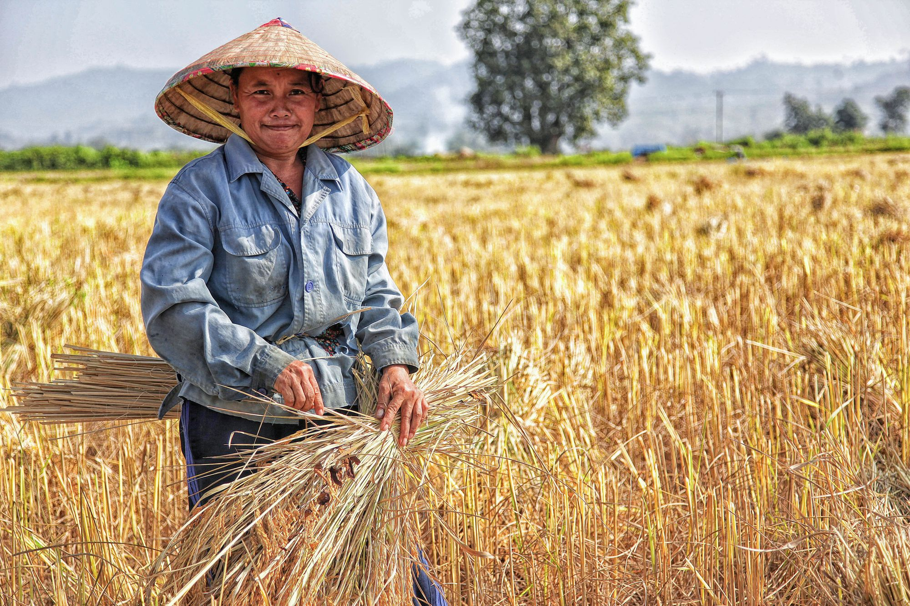
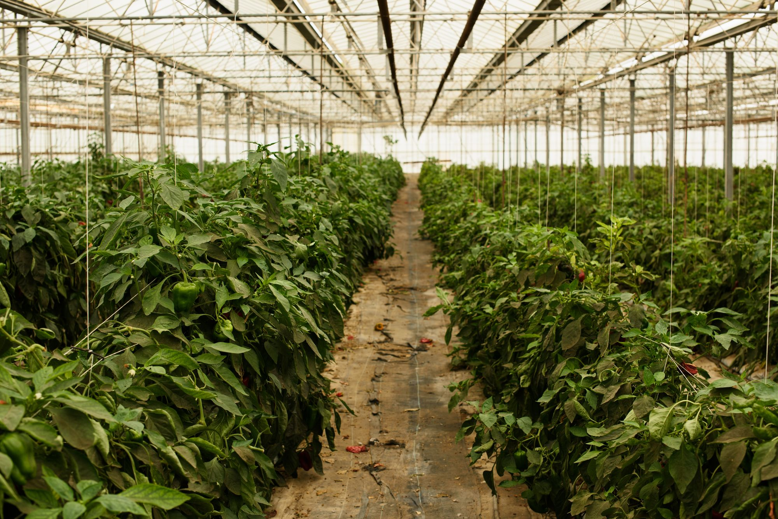
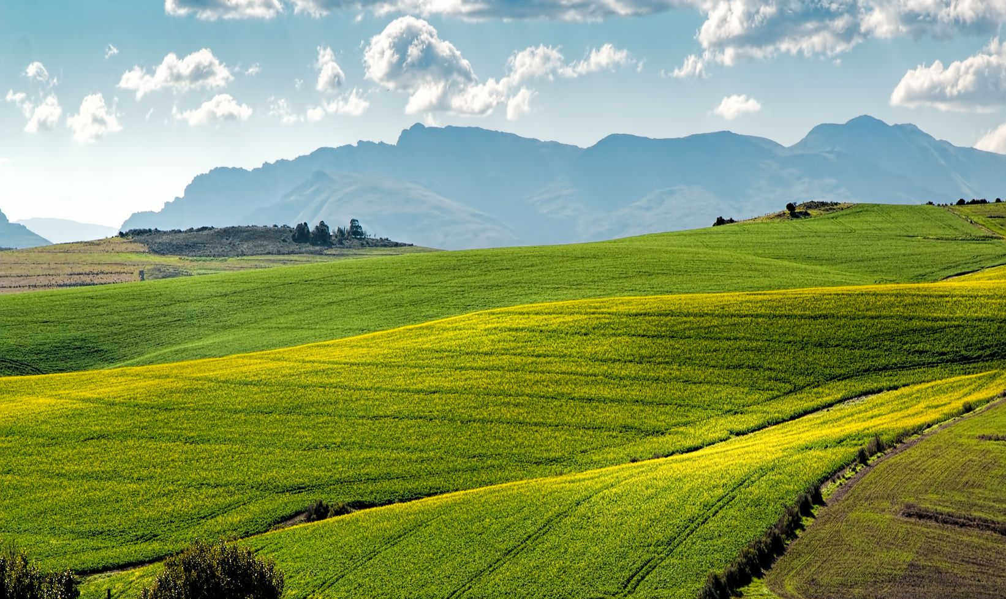
Objectives
04
Empower Farmers: Provide farmers with a digital platform to manage and sell their products directly, eliminating the need for middlemen.
Increase Market Reach: Expand farmers' access to a broader consumer base, enabling better pricing and sales opportunities.
Simplify Buying Process: Create a seamless, user-friendly interface for consumers to browse, purchase, and track orders.
Ensure Secure Transactions: Integrate reliable payment systems to offer secure and convenient payments for both farmers and buyers.
Boost Agricultural Sustainability: Promote fair trade practices and improve profitability for small-scale farmers in the digital marketplace.

Slide 5
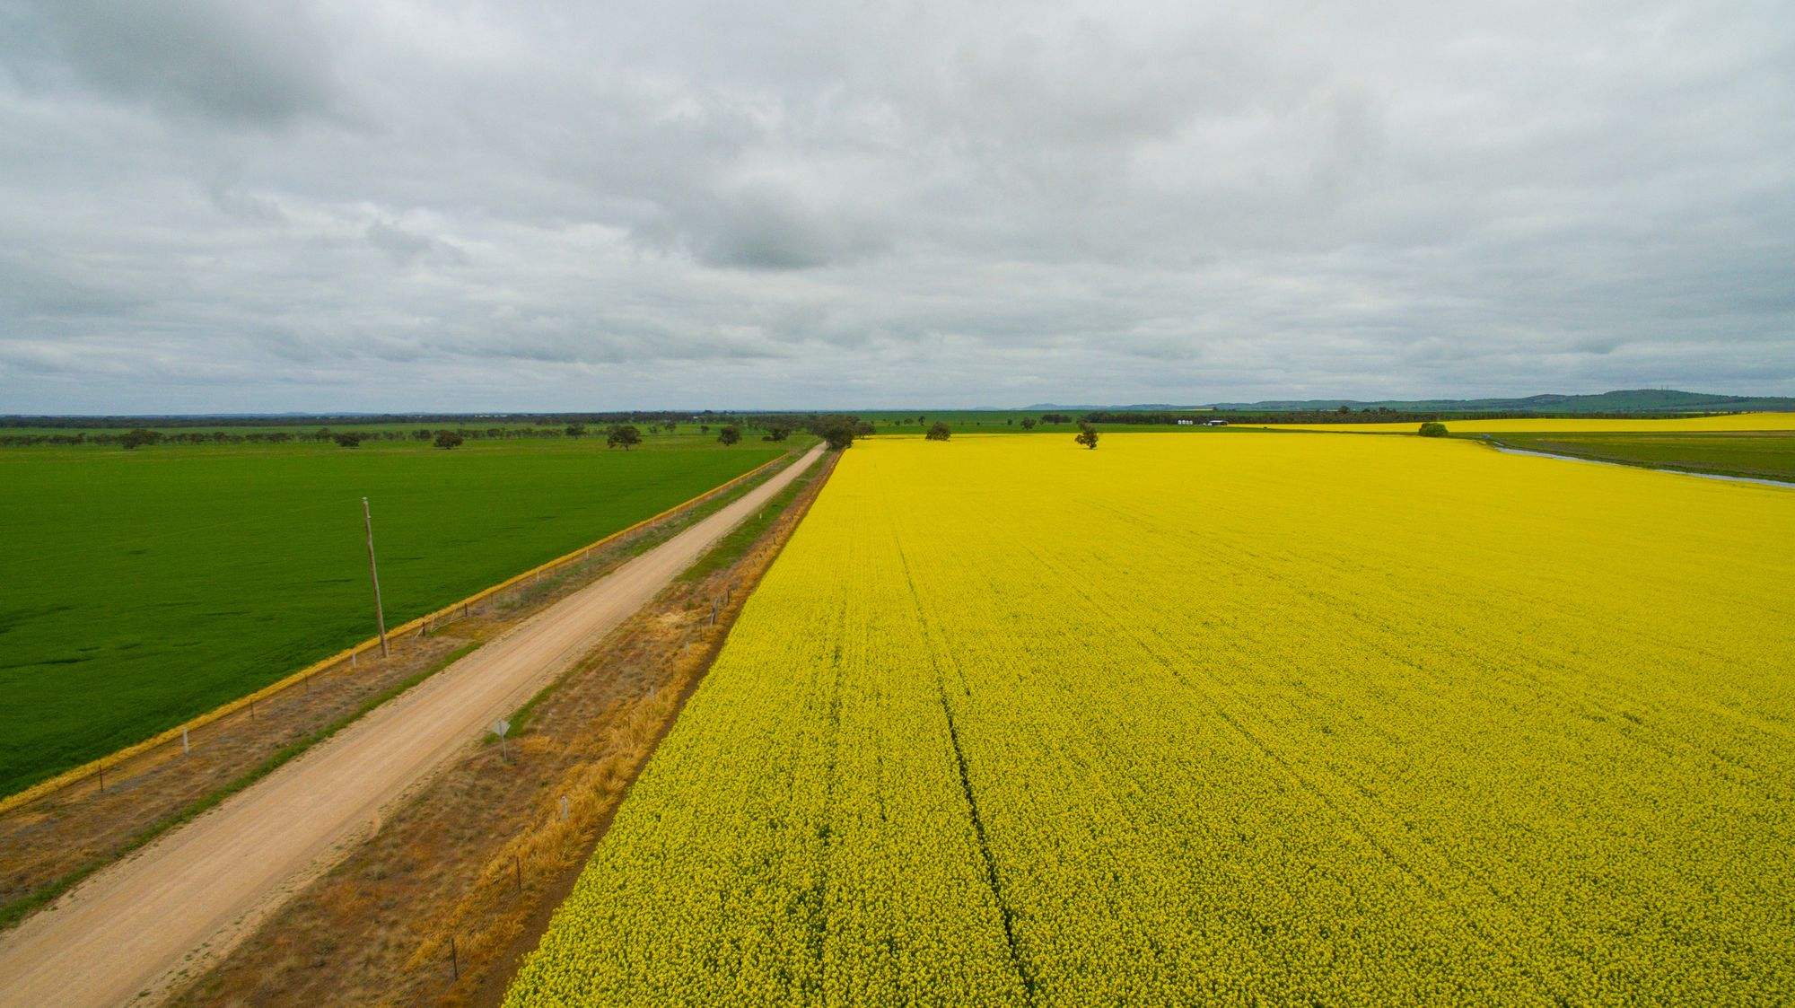
Technology Stack
Backend: Django Framework
Django is a high-level Python framework known for its security features, like built-in protection
Its scalability allows for managing complex user interactions, such as product listings, orders, and user authentication, making it ideal for an
e-commerce platform.
Frontend: HTML, CSS
These technologies provide a responsive, modern interface that ensures the platform works seamlessly across all devices, including mobile.
They enable smooth user interactions, such as browsing products and adding items to the cart, while offering flexibility for future design upgrades.
Database: SQLite
SQLite is lightweight, making it efficient for managing core data like products, orders, and users in small to medium-scale projects.
It's easy to set up and integrates smoothly with Django, ensuring data integrity and scalability as the platform grows.
05

Slide 6
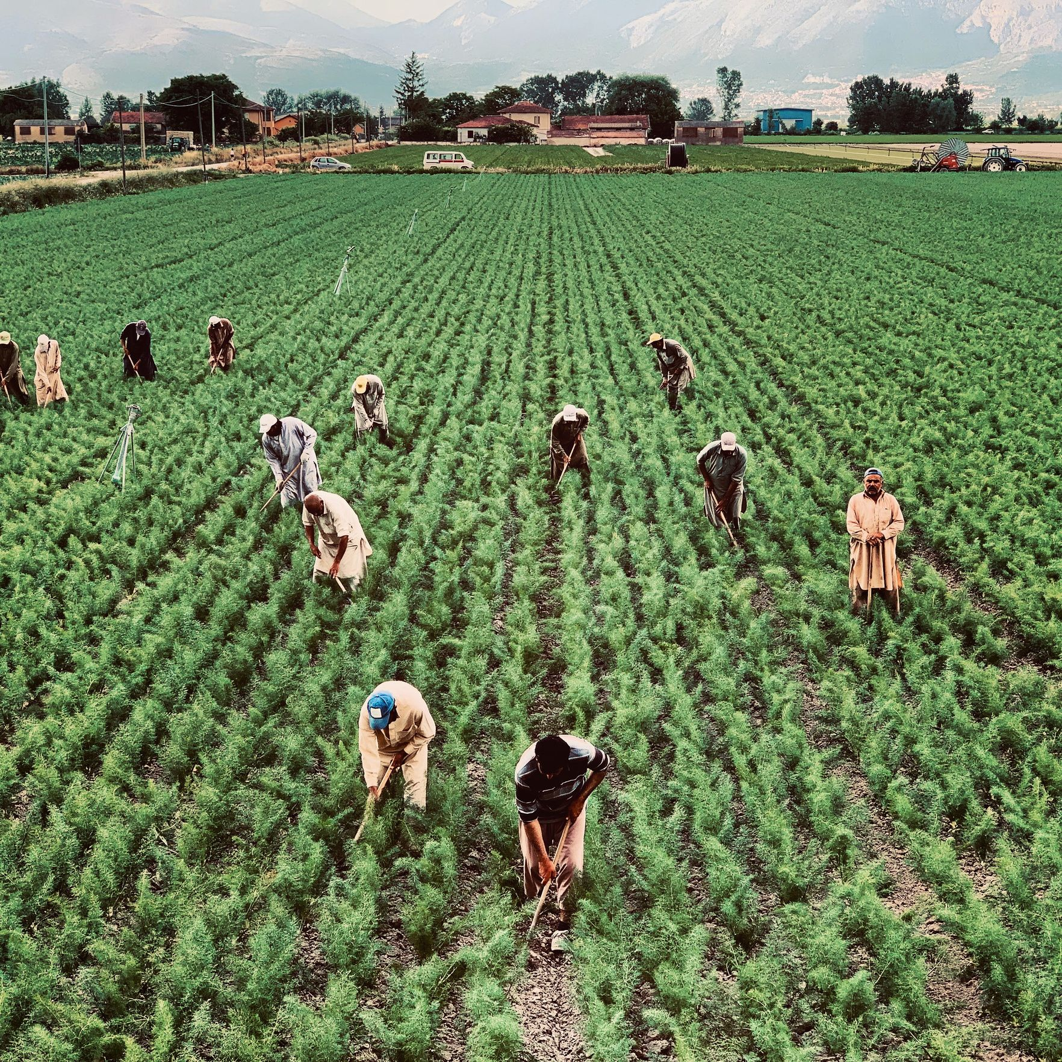
06
Website Features
User Authentication: Secure login system with role-based access for farmers and buyers.
Product Management: Farmers can easily add, manage product listings, complete with images and descriptions.
Category Management: Organizing products into categories (fruits, vegetables, oil, seeds/grains and Dai) for easier browsing.
Cart & Checkout: Buyers can add products to their cart, view total costs, and proceed to checkout for seamless transactions.
Order History: Users can view current order status and manage delivery details.
Review System: Buyers can leave feedback on products, helping farmers improve and encouraging trust in product quality.

Slide 7
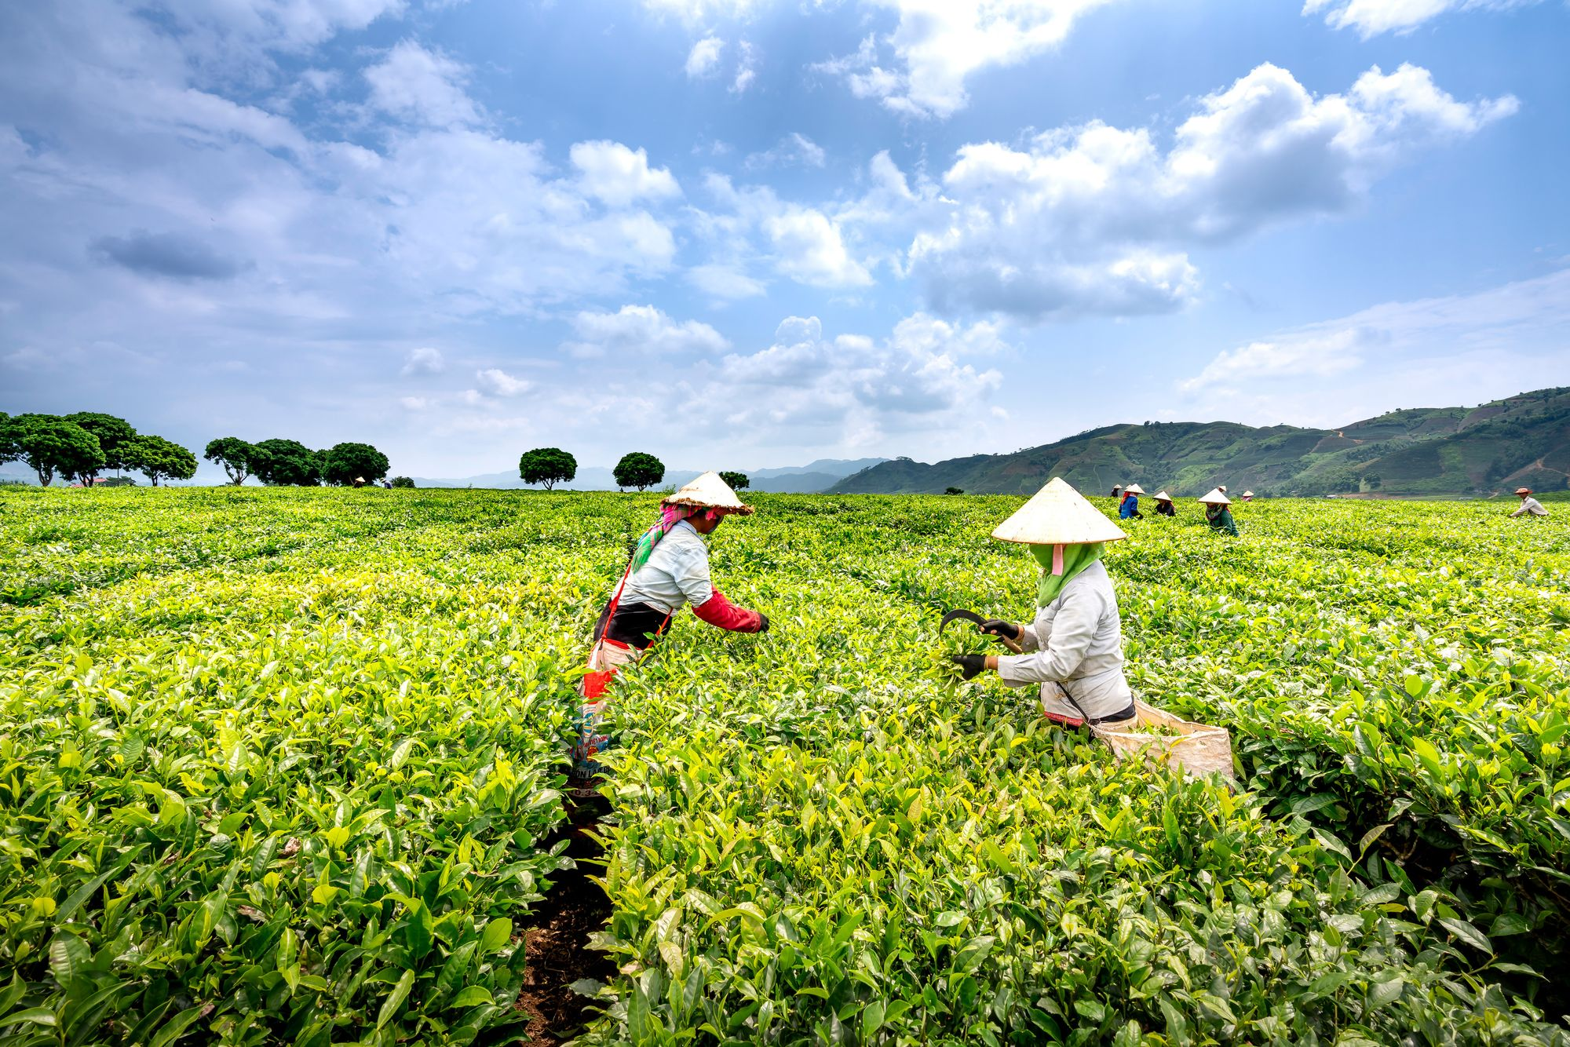
User Interface Design
Home Page
Category Page
Product Detail Page
A visually captivating homepage featuring high-quality images of fresh produce and highlighted deals or seasonal products. Clear navigation with prominent categories and search functionality, enabling users to quickly find what they're looking for
Organized and intuitive, allowing users to filter products by categories (e.g., vegetables, fruits, grains/seeds, oil, dairy).
Additional filters for price range, location, and availability ensure buyers can find specific products with ease.
Comprehensive product view with high-resolution images, detailed descriptions, and pricing.
User-generated reviews and ratings provide social proof
The page also includes stock availability
07

Slide 8
User Interface Design
Cart & Checkout:
A user-friendly cart and checkout process that allows smooth navigation from product selection to order confirmation. The cart provides a clear breakdown of item, item costs. It features a quick Edit option, allowing users to easily adjust quantities or remove items without leaving the page, ensuring a hassle-free and streamlined experience right up to the checkout step.
Profile:
A personal dashboard where users can manage their profile, past orders and manage reviews they've submitted for products.
08

Slide 9


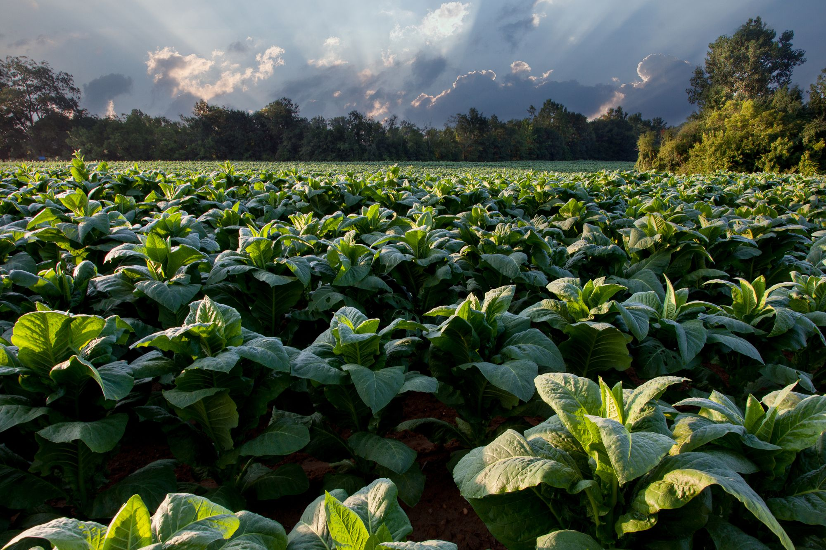

Models and Database Structure
09
Item Model: Stores information about each product, including name, price, stock, and description.
Category Model: Organizes products into logical groups (e.g., Dairy, Vegetables).
User Model: Tracks both farmer and buyer data, differentiating access rights.
Order Model: Manages the details of placed orders, including product, quantity, and buyer.
Transaction Model: Logs payment details and statuses for each order.
Review Model: Collects buyer feedback, ensuring transparency and trust in product quality.

Slide 10
10
Walkthrough
Step 1: User Registration and Login
Step 2: Product Management for Farmers, Browsing for Buyers
Step 3: Adding to Cart and Checkout
Step 4: Order Confirmation
Step 5: Feedback and Review

Slide 11
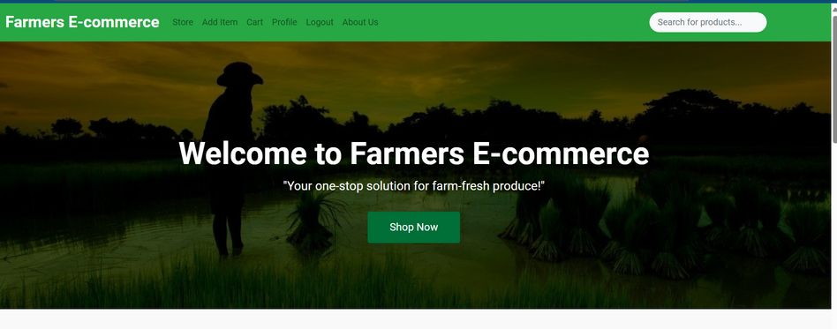
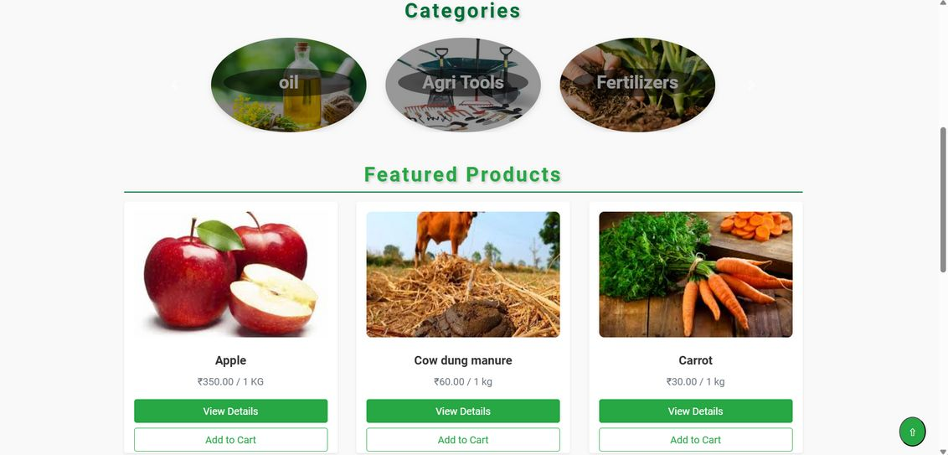
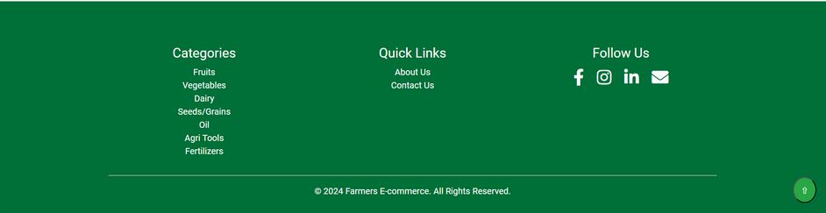
Home Page

Slide 12
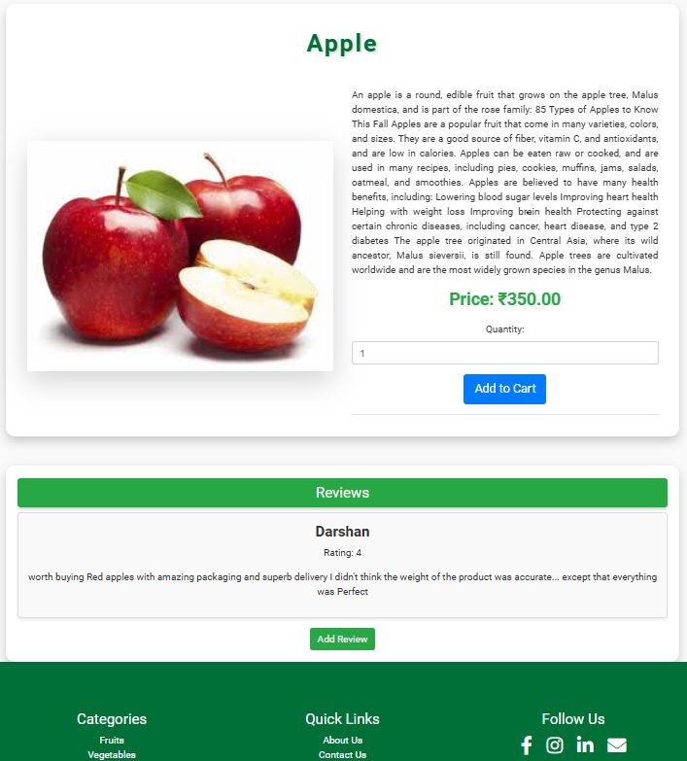
Product Page

Slide 13
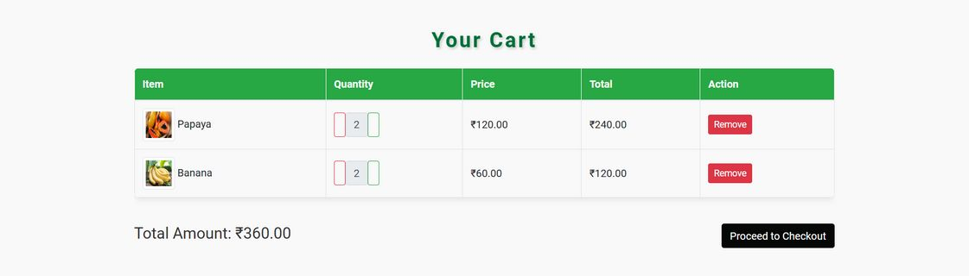
Cart Page

Slide 14
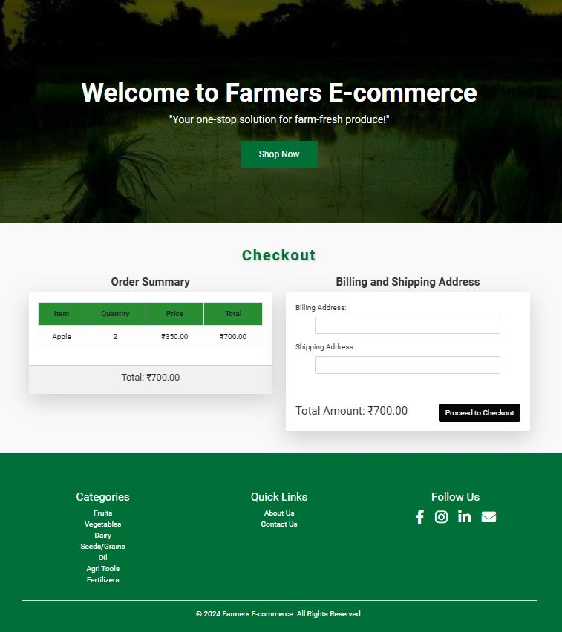
Checkout Page

Slide 15

Payment Page

Slide 16
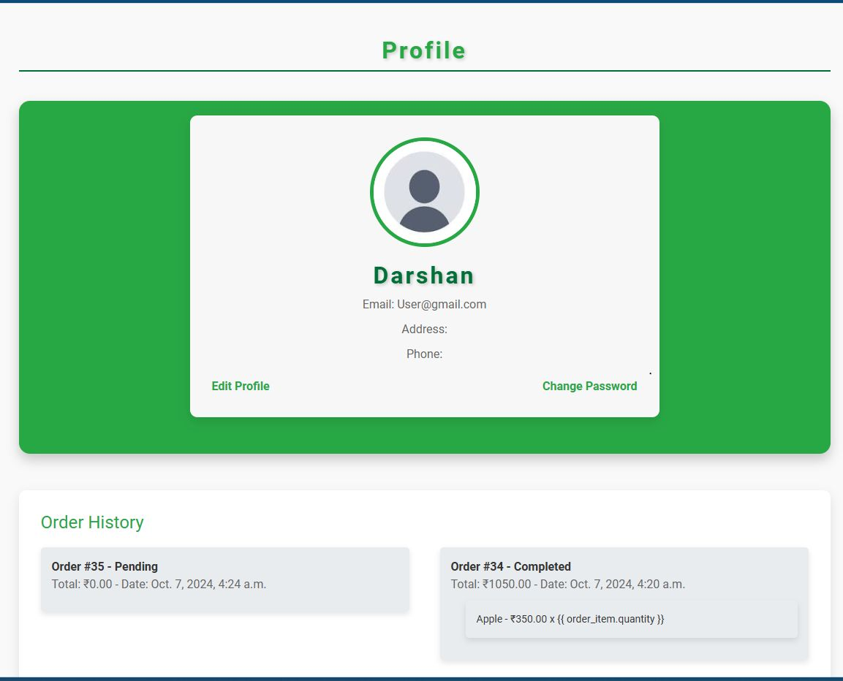
Profile Page

Slide 17
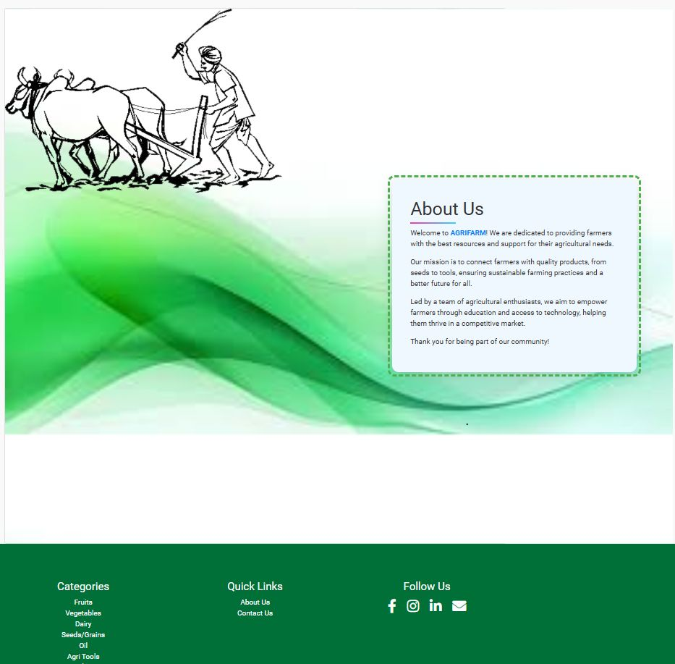
About Us Page

Slide 18
Future enhancement
Mobile Application: Launch a mobile app to reach a wider audience, focusing on rural areas with smartphone access.
Language Support: Add multilingual support for regional languages, making it easier for farmers across different states.
AI Recommendations: Implement an AI-driven recommendation system that suggests crop pricing based on market trends and demand analysis.
18

Slide 19

19
Conclusion
The Farmer's E-Commerce platform revolutionizes agricultural sales by directly connecting farmers with consumers through a simple, efficient online marketplace. It empowers farmers to take control of their product listings and pricing, boosts their profits by eliminating middlemen, and offers consumers a seamless buying experience. With a secure, scalable infrastructure, this platform is designed to modernize farming, promote fair trade, and foster sustainable growth in the agricultural sector, benefiting both farmers and buyers alike.

Slide 20

Thank You!

